Slide 1

Beyond praying for rain: Quantifying natural recovery outcomes for the Great Salt Lake
Mason Buckman, Lindsey McGuire, Clara Garcia, Kim Lanaghen
This Photo by Unknown Author is licensed under CC BY-NC

Slide 2
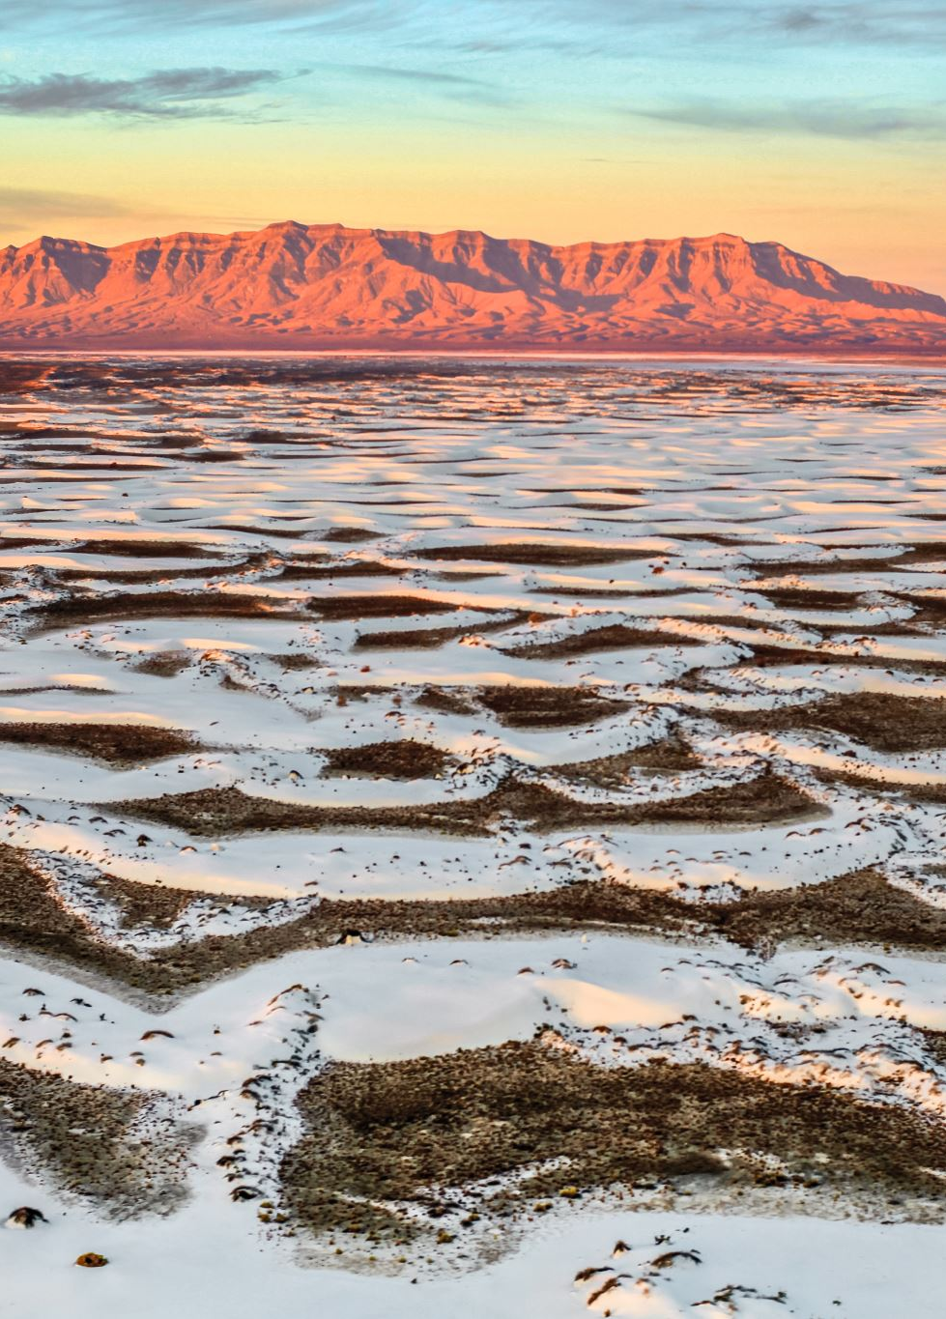
Background and Motivation
The Great Salt Lake has experienced a prolonged decline in water levels, reaching historic lows in recent years
As water levels decrease, salinity rises — disrupting ecosystems and industries tied to the lake
Shrinking lakebed exposes toxic dust and sediments, threatening surrounding communities
Public discourse has centered on "praying for rain" — but does natural precipitation actually move the needle?
This project investigates whether historical precipitation and snowpack patterns can predict lake level outcomes

Slide 3
Questions and Analysis Methods
Questions
Analysis Methods
What years look similar to one another using climate predictors and KMeans clustering?
Are there strong features that correlate to one another or to lake levels?
Can we model future lake outcomes using k-NN sample bootstrapping?
Yearly vectors built from all features, KMeans clustering, PCA for visualization
k-NN analog bootstrapping (inspired by Lall & Sharma) — 100 simulations projecting 15 years of lake elevations
Simulation result: slight average elevation increase projected, but unlikely to reach lowest healthy level without reducing human impacts

Slide 4
Data Sourcing and Acquisition
USGS NWIS REST API — monthly lake surface elevation at Saltair Boat Harbor (1950–2024)
NOAA CDO REST API — monthly precipitation data from SLC Airport station (1950–2024)
NRCS SNOTEL network — historical snow water equivalent data (1989–2026)
USGS GSL Hydromapper — major tributary inflow: Bear (57%), Weber (20%), Jordan (16%)
USGS Science Data Catalog — GSL Elevation-Area-Volume tables for evaporation modeling
All sources are federal/public domain; data combined into a single monthly dataframe

Slide 5
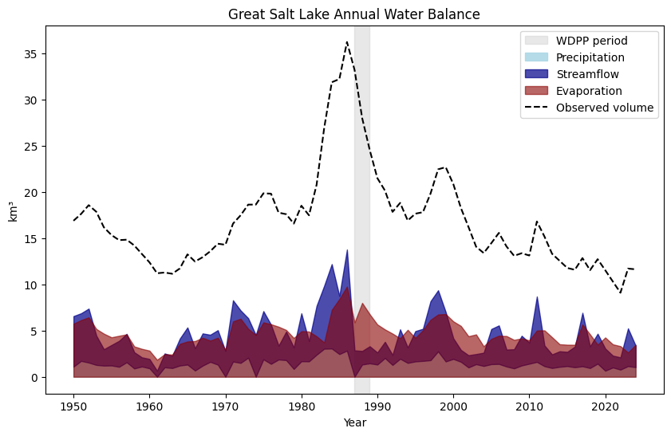
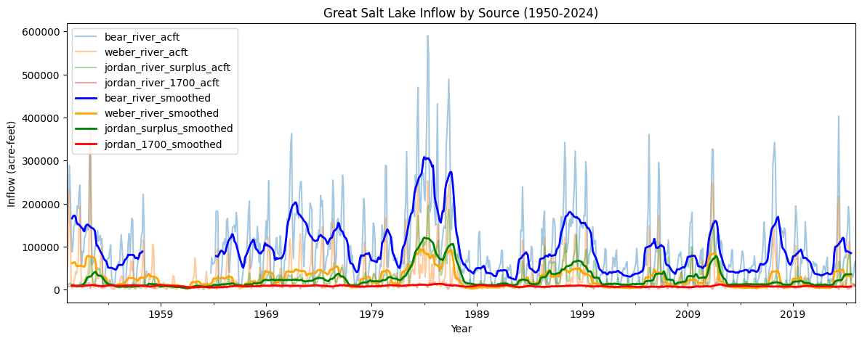
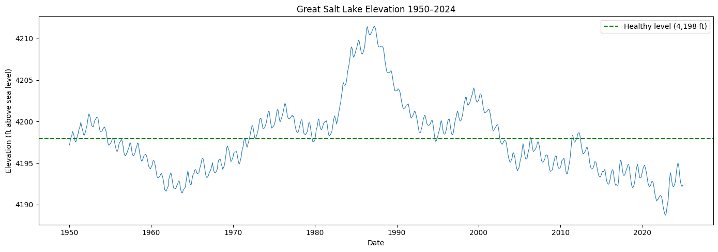
Preliminary Analysis
We can see clearly the impact that flooding in the 1980s had on lake levels.
After taking a dive in the early 2000s, lake levels have fluctuated but have not returned to baseline healthy levels

Slide 6
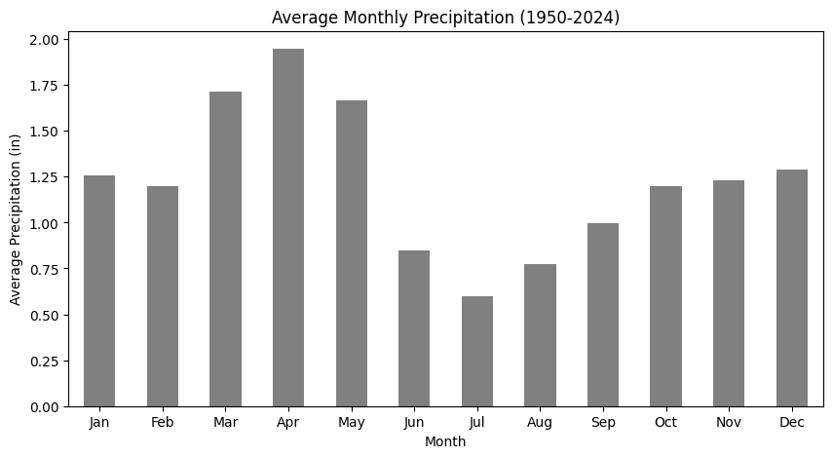
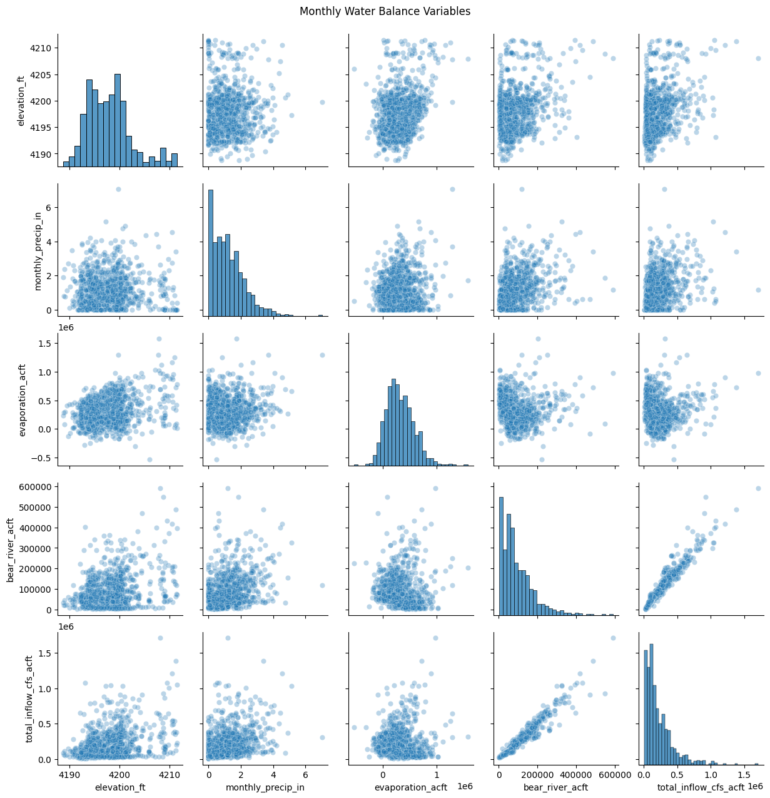
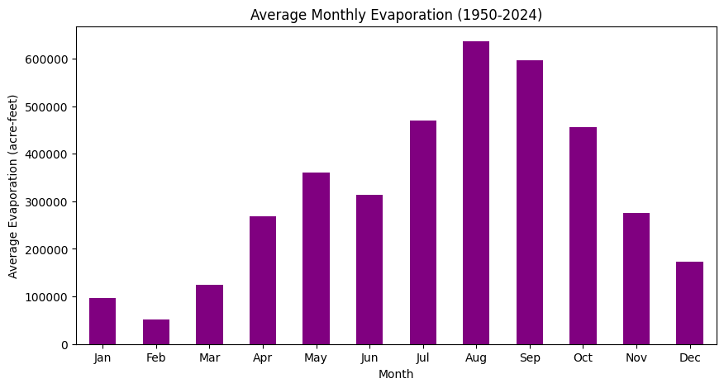
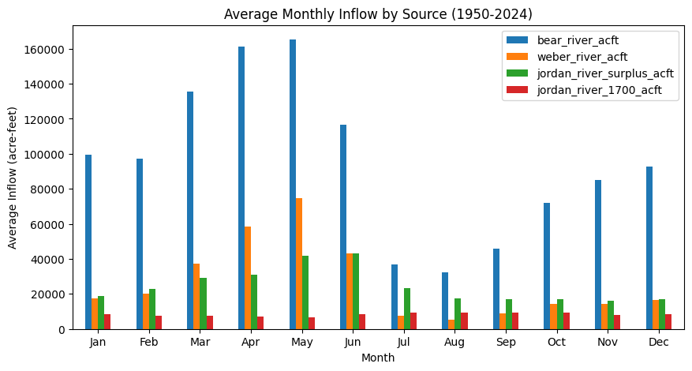
Monthly metrics for each feature and scatter plot matrix

Slide 7
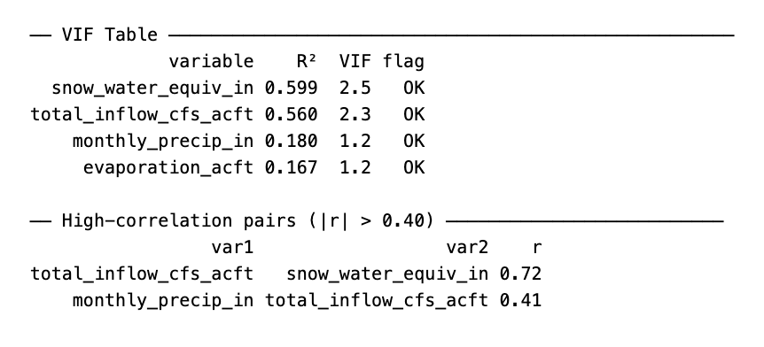
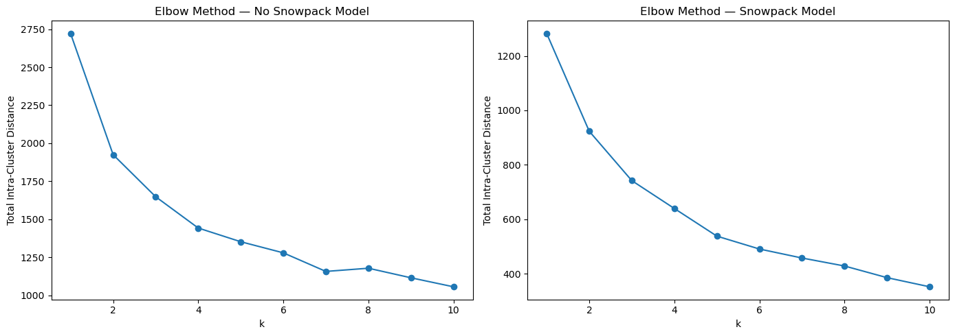
Elbow Plots and VIF
Pre-Clustering analysis
Checking for optimal K
Checking for multicollinearity to prevent overfitting of our model
Results
No multicollinearity flags
Optimal k not obvious, but usable
Non-snow: k = 4
Snowpack: k = 3

Slide 8
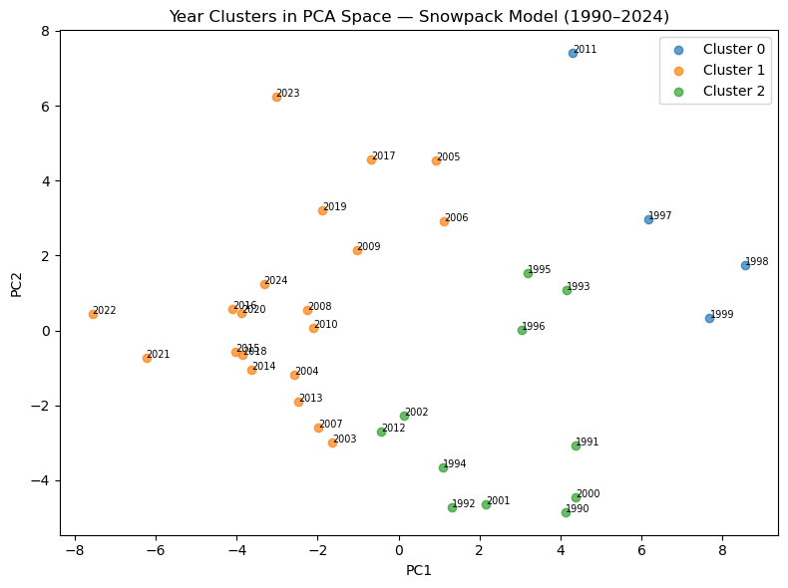
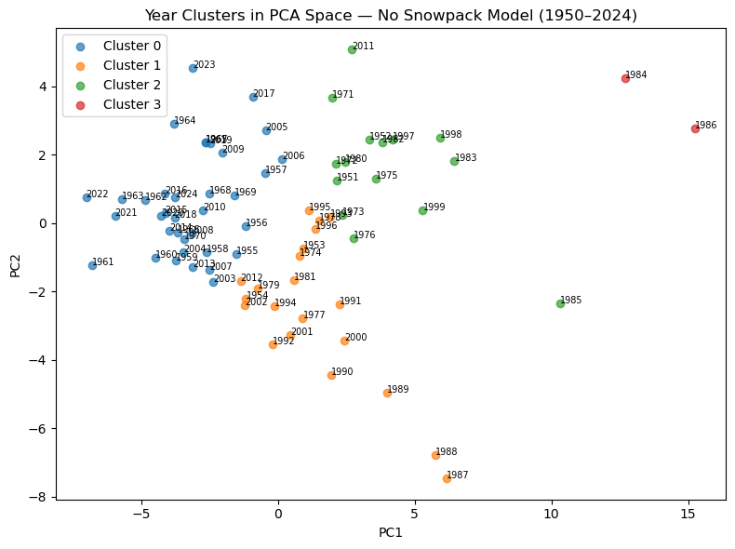
KMeans Clustering and PCA
Clustering performed on 48- and 60- dimensional yearly vectors
Compressed to two principal components for visualization (~37% variance lost, still valuable)
Demonstrates clustering of wet/dry/transition years

Slide 9
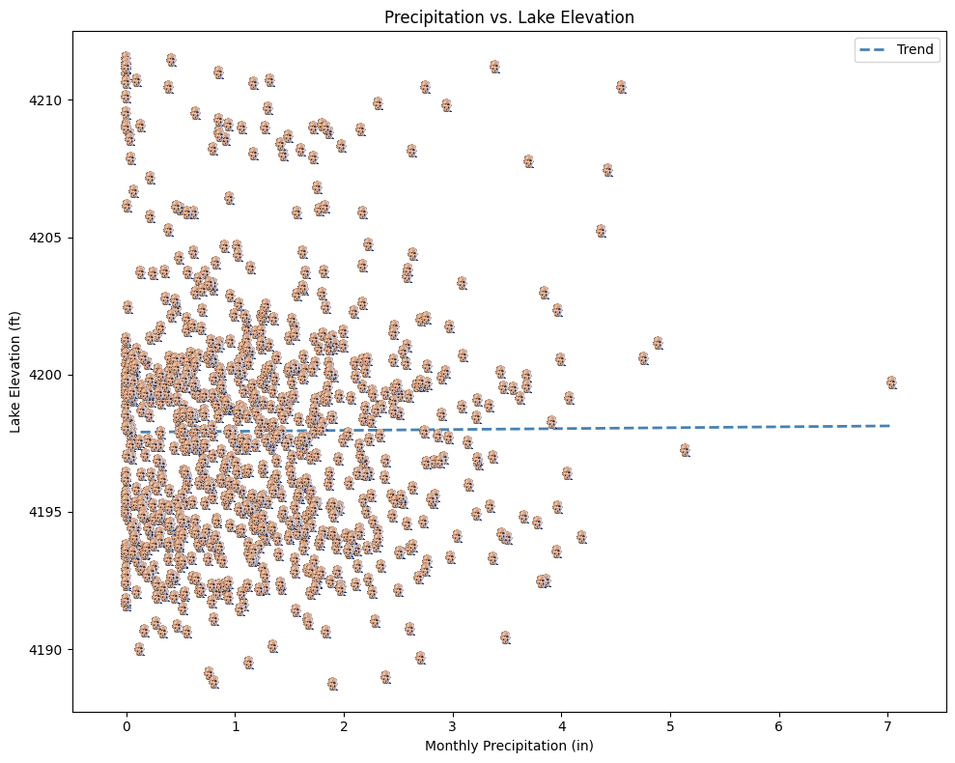
Scatter Plot of Precipitation vs Lake Elevation
Confirms that Precipitation cannot be the only factor that influences lake elevaiton

Slide 10
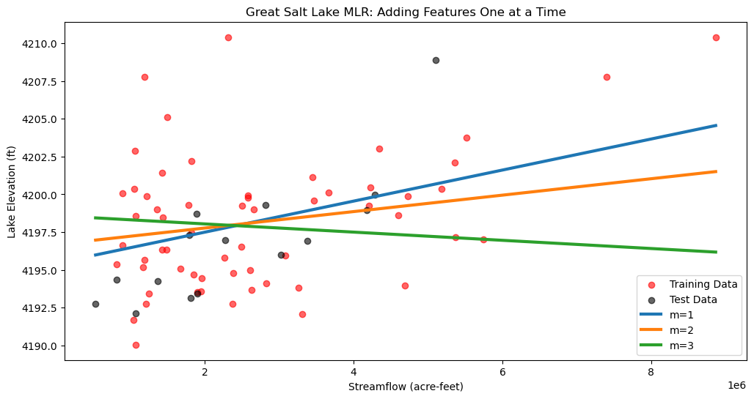
Multiple Linear Regression
fit the model adding one feature at a time
m=1: inflow only
m=2: inflow + precip
m=3: inflow + precip + evaporation
Shows us how much each variable improves the model

Slide 11
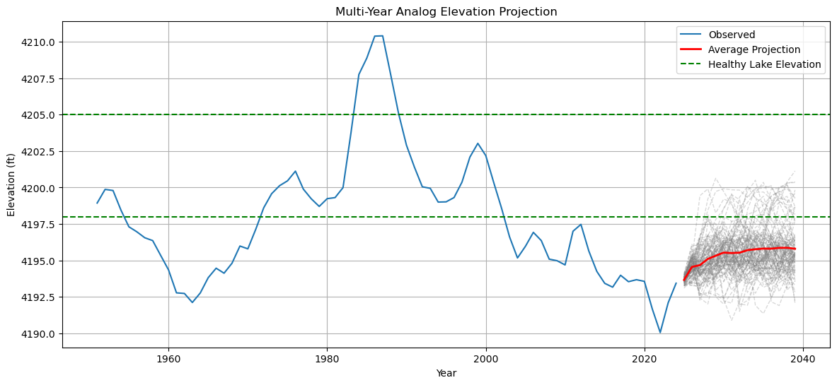
K-NN Predictor
Ran 100 simulations of what lake levels might look like in the next 10 years using four predictors.
Lake levels will not likely return to healthy levels, and lake elevation will level out at about 4196 ft above sea level

Slide 12
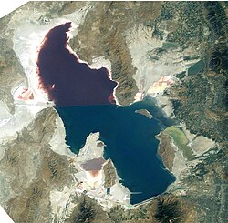
Results
PCA:
No obvious trends in years that are clustered together
1984 and 1986 are outliers
k-NN:
Lake levels will likely not return to healthy
Because iterated over historical data, we future predictions are confined to the bounds of each predictor used.
This Photo by Unknown Author is licensed under CC BY-SA

Slide 13

THANK YOU

